Slide 1
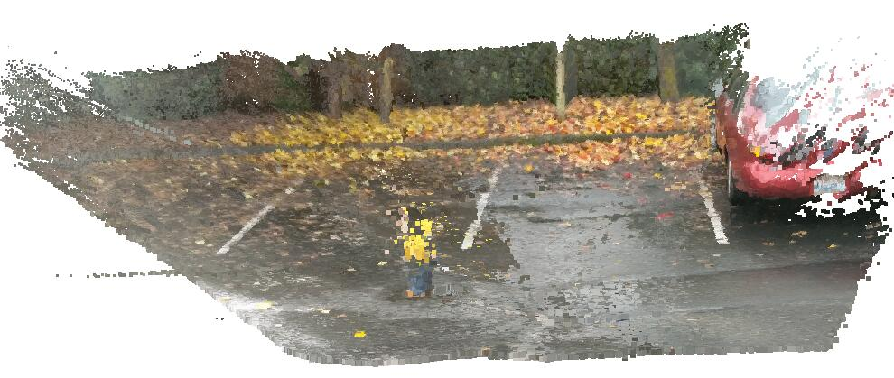
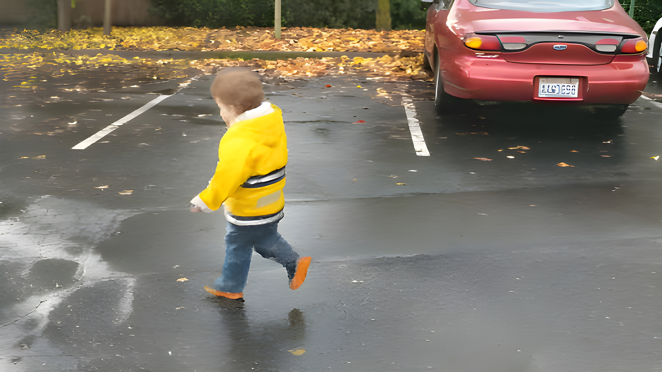


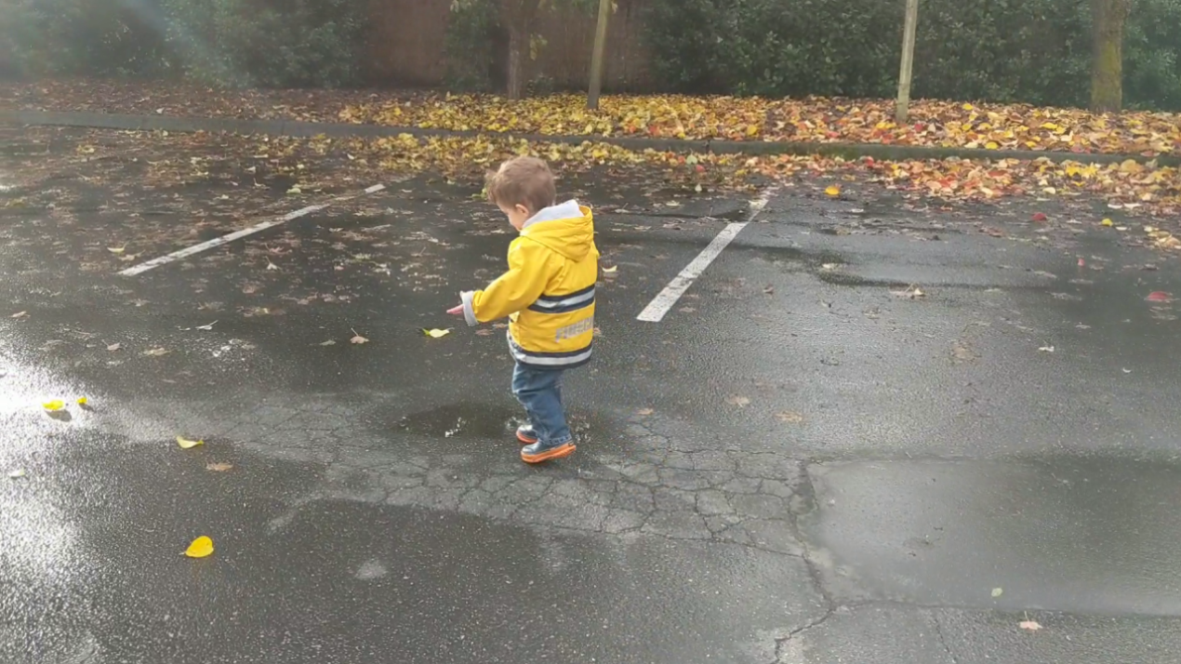
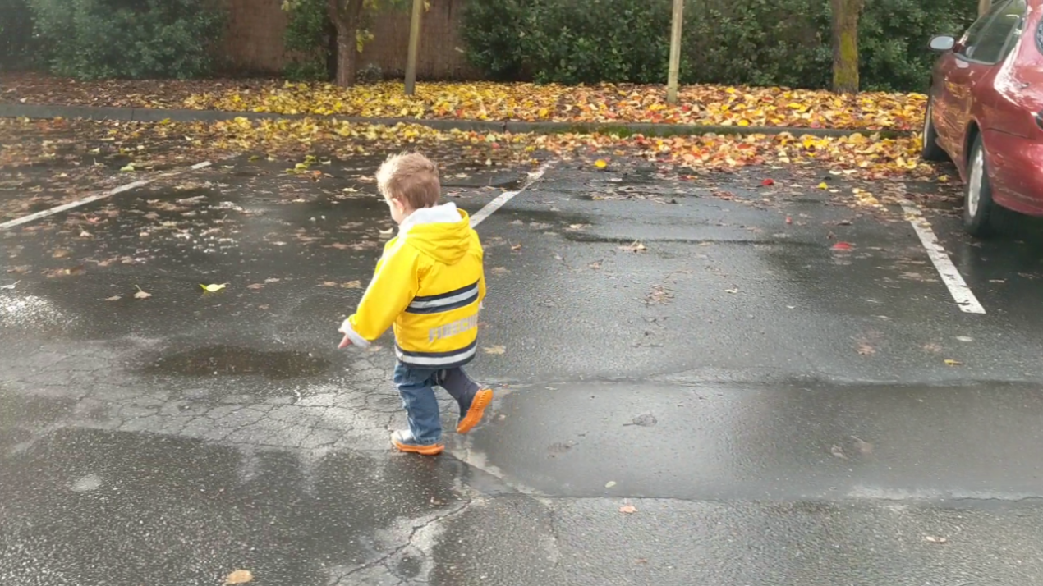
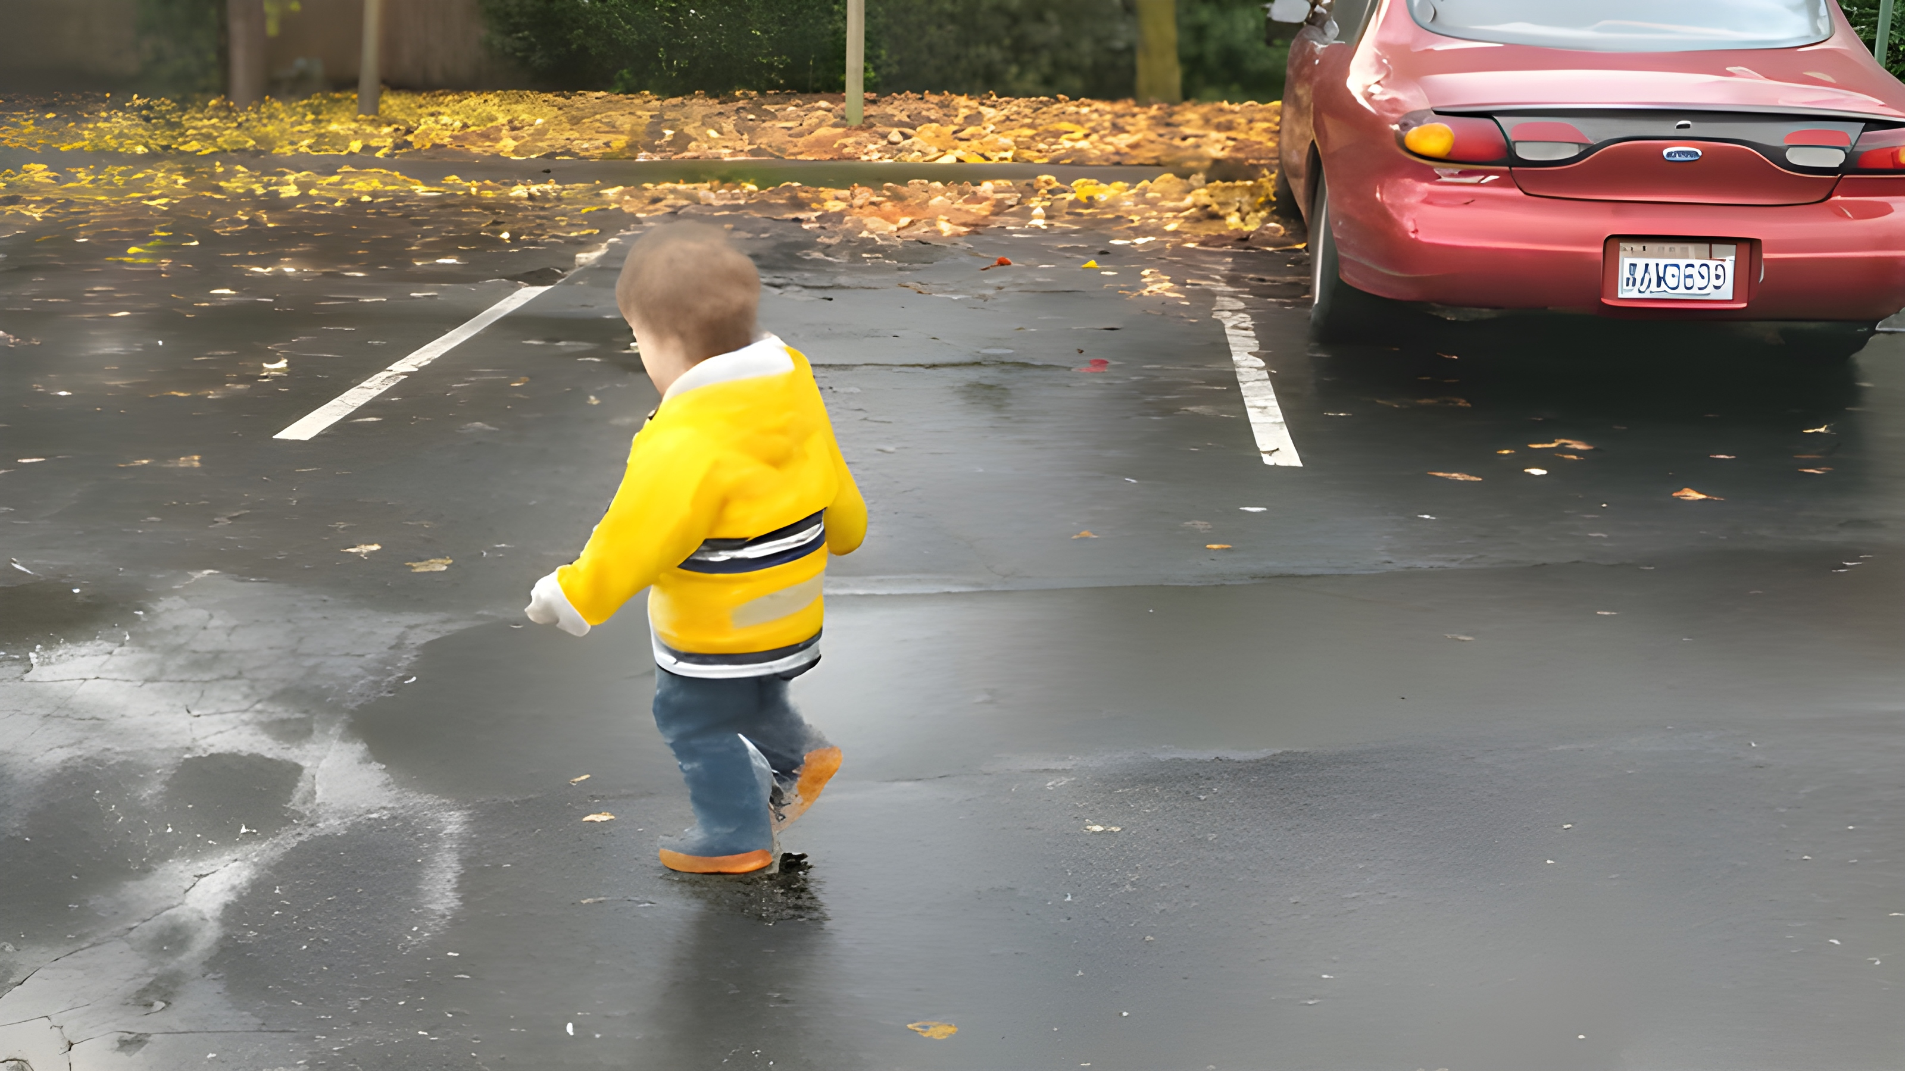
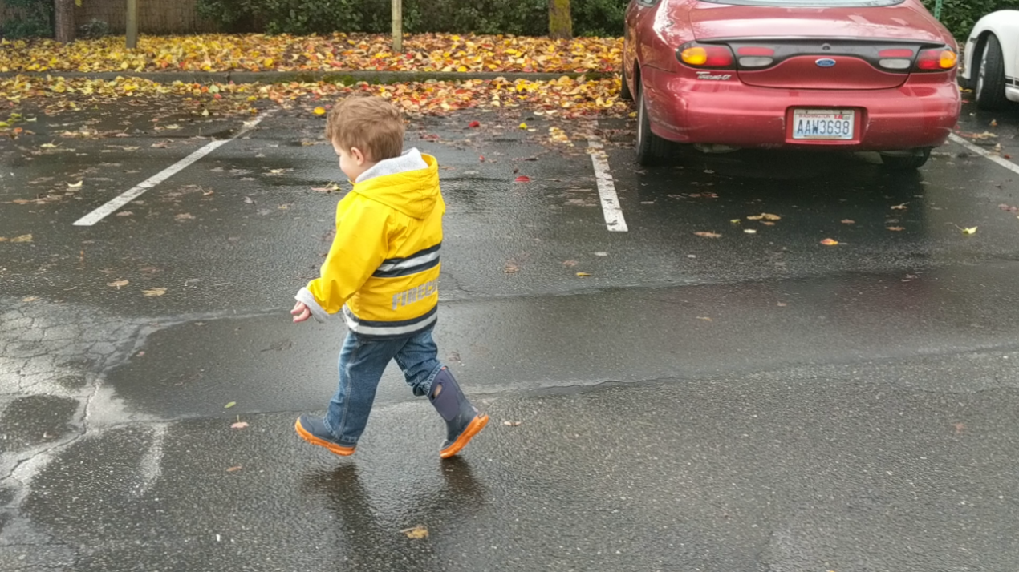
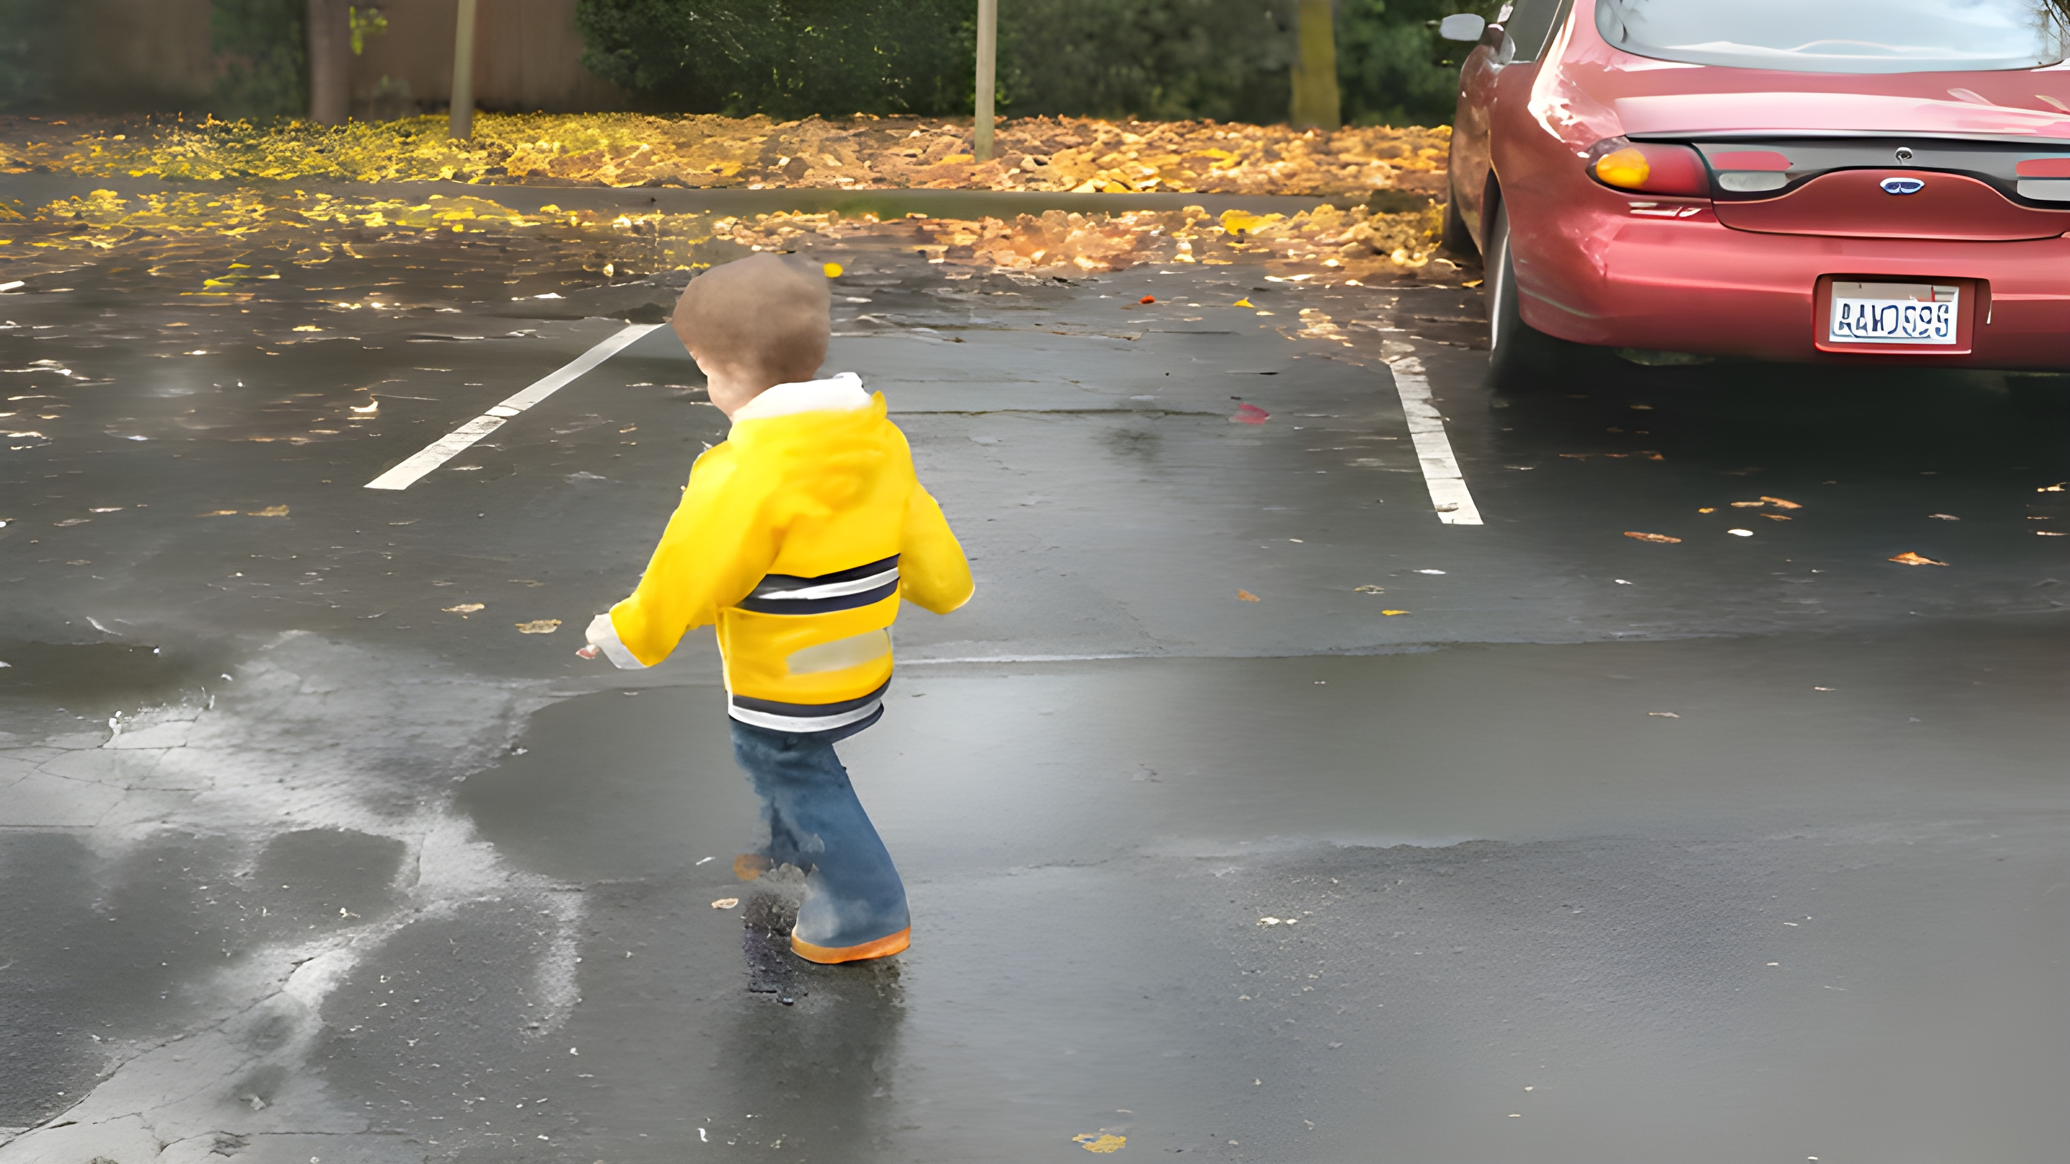

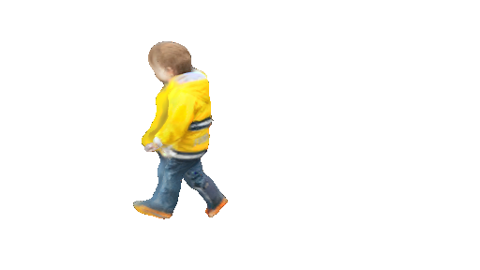
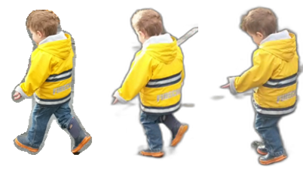
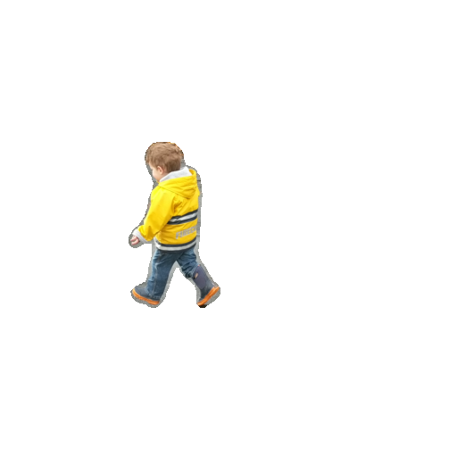

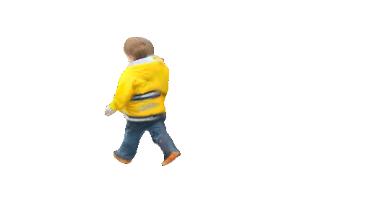
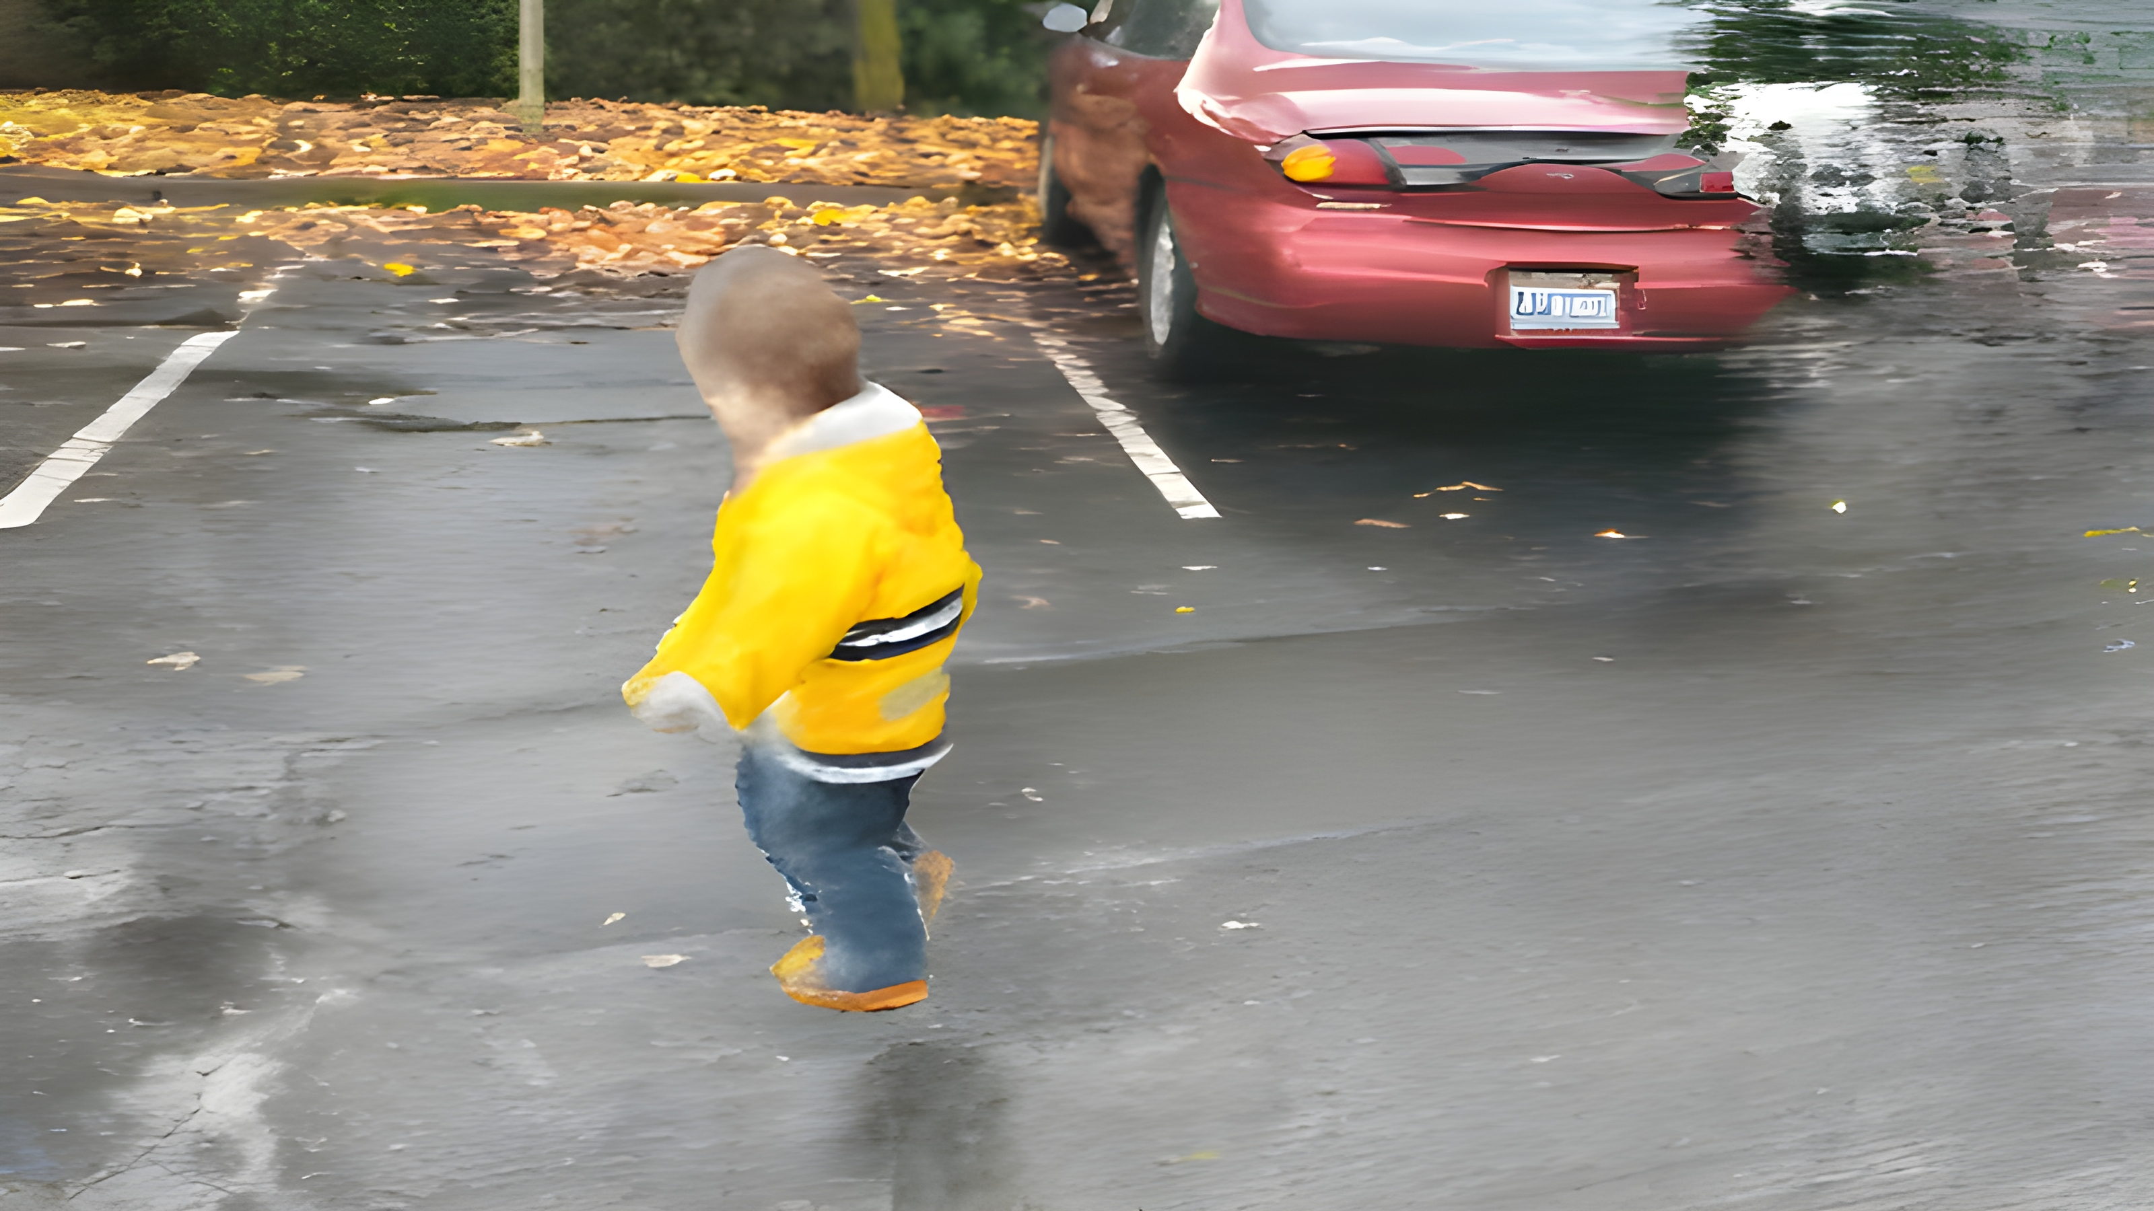
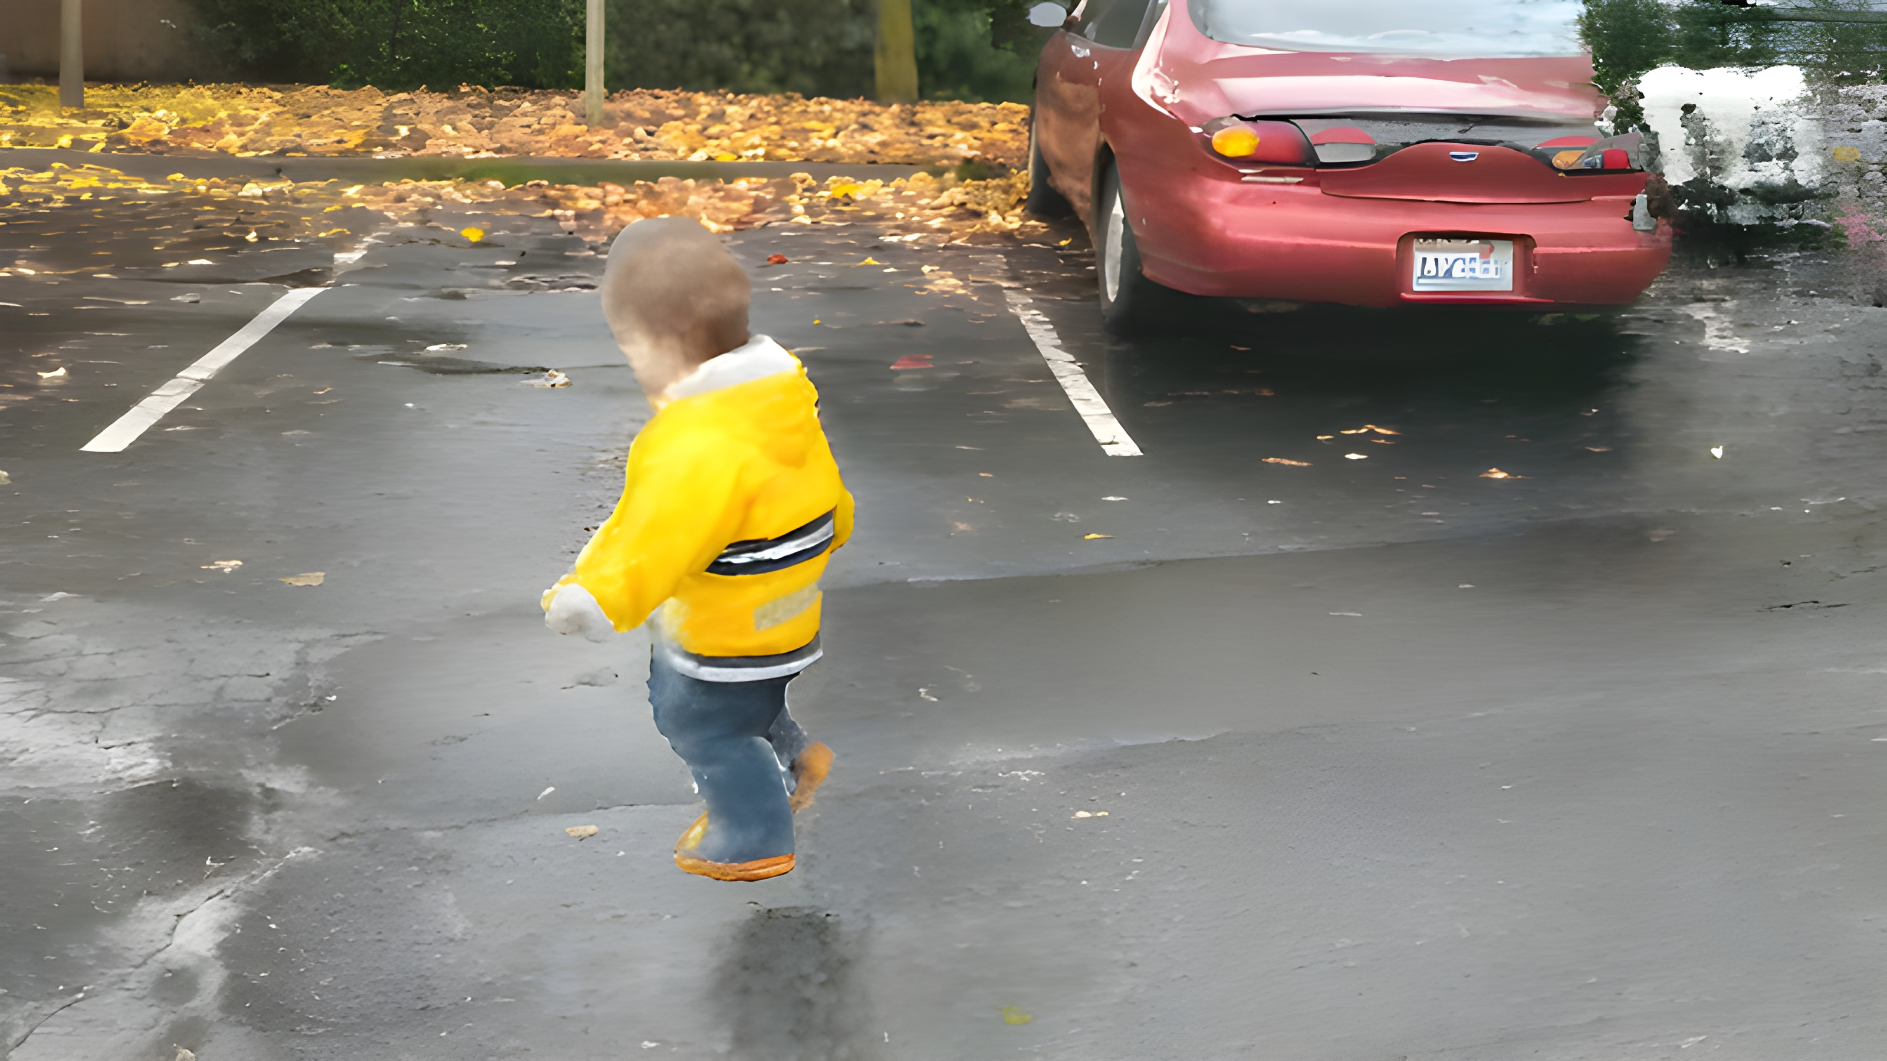
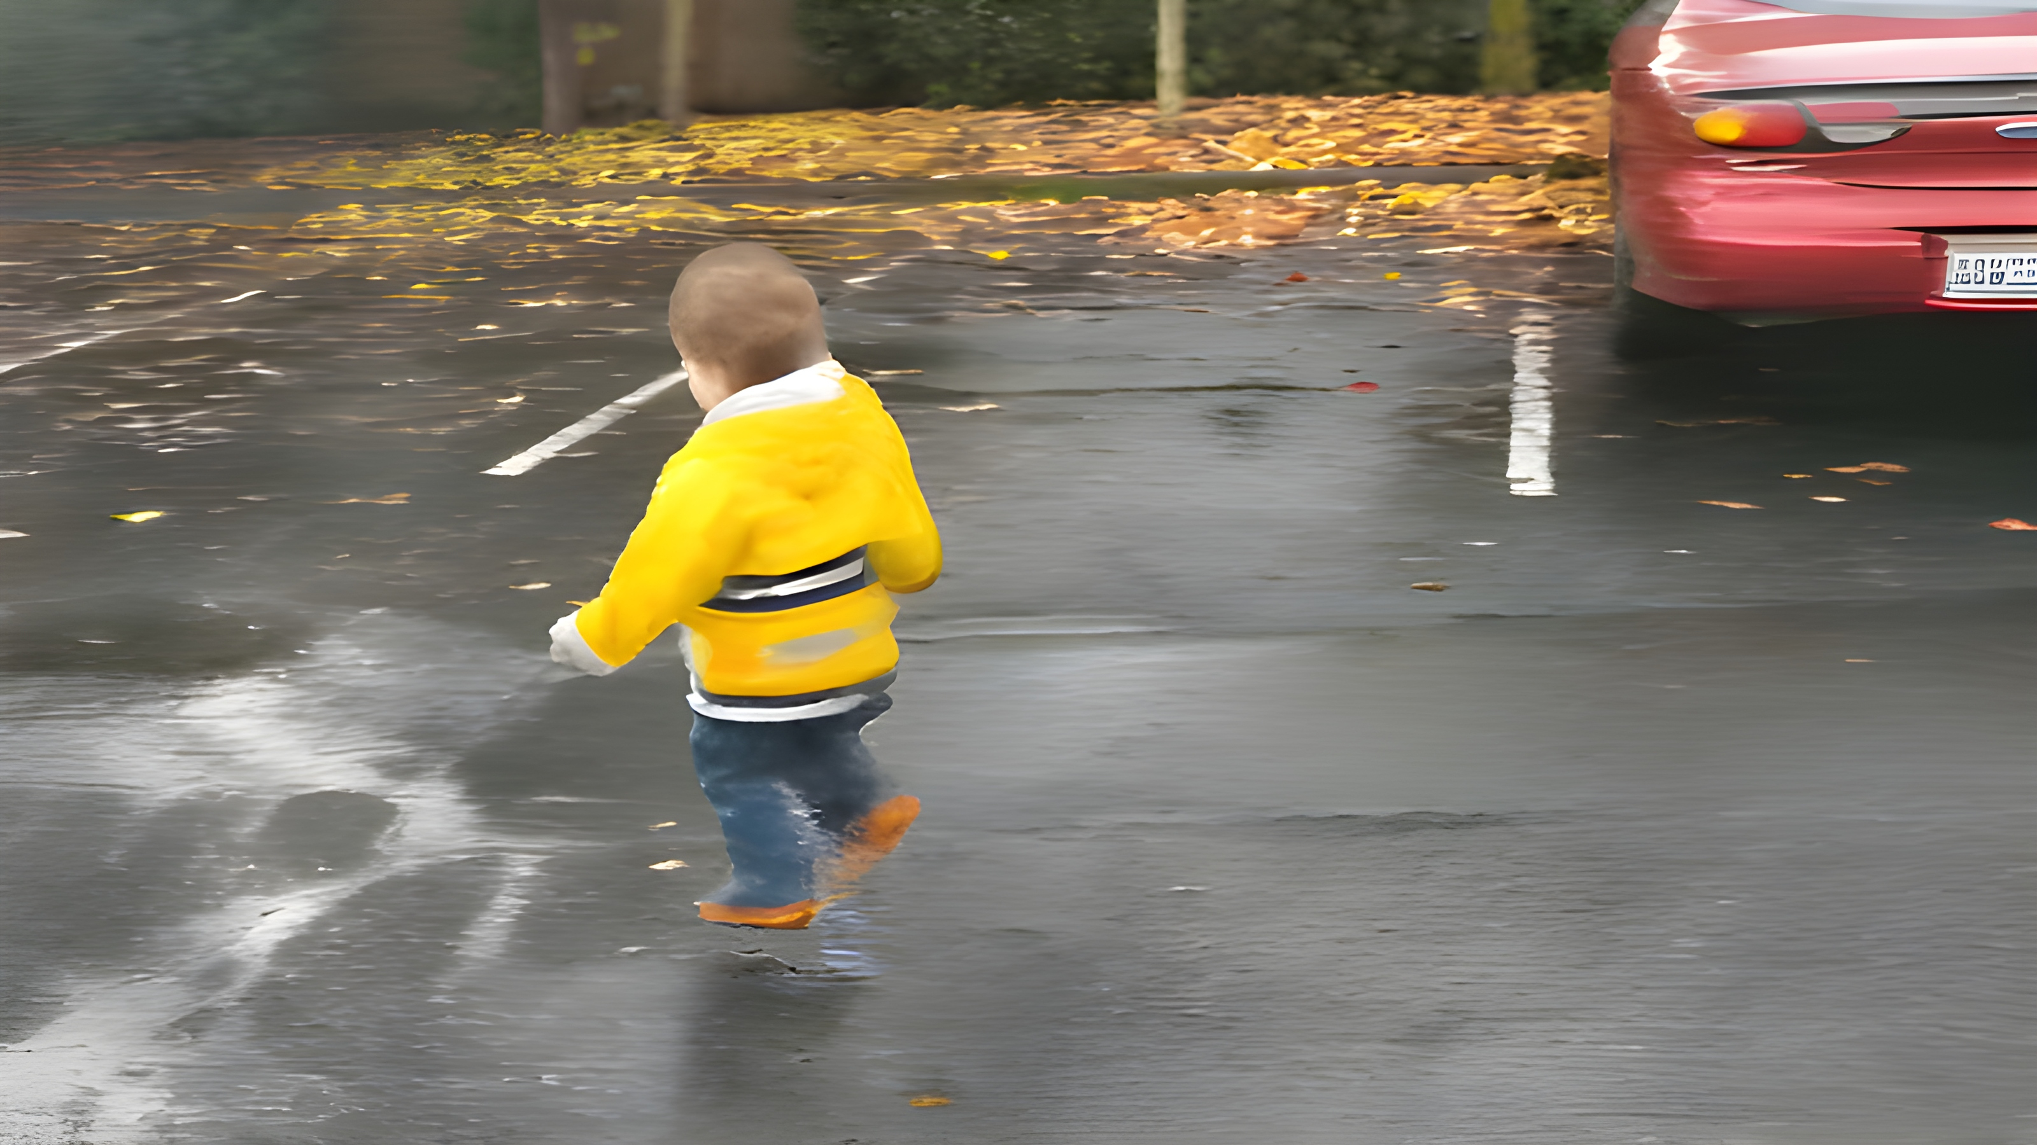
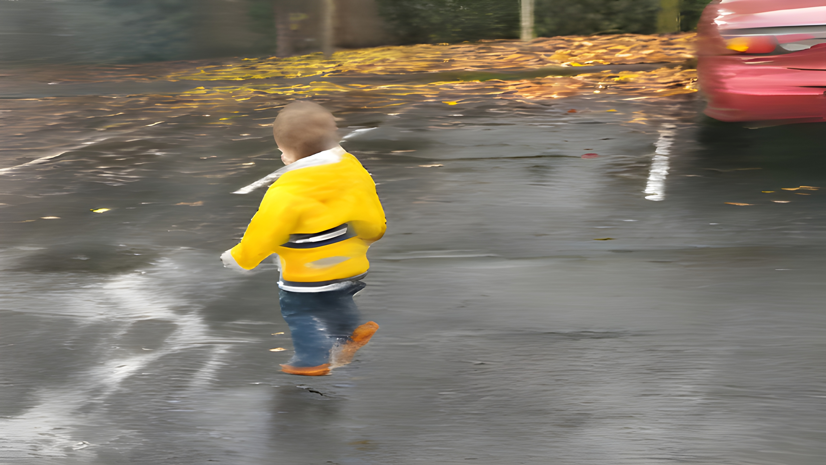
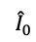
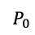
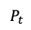
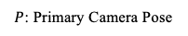
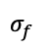
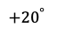
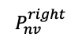
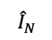
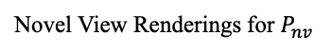
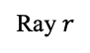
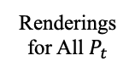
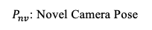
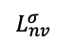
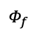

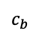
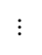
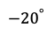
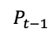
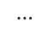
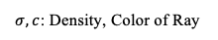
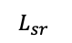
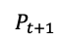
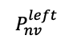
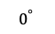
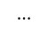
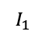
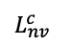
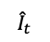
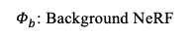
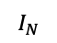
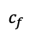
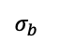
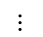
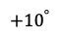
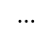








$Φ_{b}$: Background NeRF
$Φ_{f}$: Foreground NeRF
Ray $r$
$P$: Primary Camera Pose
$$L_{sr}$$
$P_{nv}$: Novel Camera Pose
Backbone Dynamic NeRF
$σ,c$: Density, Color of Ray
$$Φ_{b}$$
$$σ_{b}$$
$$c_{b}$$
$$⋯$$
$$⋯$$
Static
Super Resolution
$${\hat{I}}_{0}$$
$$I_{N}$$
Encoder
$$⋰$$
$$P_{0}$$
$$⋯$$
$$P_{t}$$
$$P_{t+1}$$
$$P_{t−1}$$
$$P_{N}$$
$$I_{1}$$
$$⋯$$
$$Φ_{f}$$
$$σ_{f}$$
$$c_{f}$$
$$⋯$$
$$I_{0}$$
$$L_{nv}^{σ}$$
$$L_{nv}^{c}$$
$${\hat{I}}_{t}$$
Novel View Feature Optimization
$$⋯$$
Input Frames
$$P_{nv}$$
$$P_{nv}^{left}$$
Gaussian
Splatting
Prior
$${\hat{I}}_{N}$$
$$I_{t}$$
$$P_{nv}^{right}$$
3D Prior
Renderings for All $P_{t}$
Pseudo Ground Truth
$${−20}^{°}$$
$${−10}^{°}$$
$$0^{°}$$
$${+10}^{°}$$
$${+20}^{°}$$
Novel View Renderings for $P_{nv}$
Proposed Framework: Backbone of ExpanDyNeRF merges a distribution-driven static background NeRF $Φ_{b}$ with a dynamic foreground NeRF $Φ_{f}$ that forecasts foreground color $c_{f}$ and density $σ_{f} which is$utilized by a dual optimization approach for density and color features, facilitating the reconstructions from challenging novel viewpoints.
Notes:
The basic structure is shown in here. We first const
name/ group /year
equations as backup
bring up dateset for novelty

